Slide 1


Choosing the Right Data Science Services in Azure
Scale, Automate, and Deploy with Ease

Slide 2
Choosing the Right Data Science Services in Azure
Azure Machine Learning service
Azure Machine Learning Studio
Azure Databricks
Azure Data Science Virtual Machine
SQL Server Machine Learning Services
2

Slide 3
Choosing the Right Data Science Team
Data / BI Analyst
Data Scientist
Data Engineer
Data Scientist
Data Engineer
Data Science Manager
3

Slide 4




Tony McGovern
Hacker. Artist. Storyteller. Data lover.
Founder & Data Scientist
emdata.ai
@tonmcg
4

Slide 5
Session Objectives
Choose the right Azure machine learning product for the task at hand
Right-size the Azure machine learning services to fit your data science team
5
Notes:
Choose the right Azure machine learning product for the task at hand
- do you need to deploy the model and constantly monitor and update it?
- do you need to choose among a selection of models?
Right-size the Azure machine learning services to fit your data science team
- Are you going to do ETL in Azure Data Factory or in Azure Databricks?
- Which service is right if I only have one data scientist?

Slide 6
Agenda
Differentiate each of the Azure machine learning products
Identify key features of each product
Describe what use cases each product applies to
Understand which product best fits your workflow and data science team
6

Slide 7
Choosing the Right Data Science Services in Azure
Scale, Automate, and Deploy with Ease

Slide 8

Machine learning options on Azure
Azure Machine Learning service
Azure Machine Learning Studio
Azure Databricks
Azure Data Science Virtual Machine
SQL Server Machine Learning Services
8
Notes:
Since I’m only focusing on the first four – and not SQL Server Machine Learning Services – either transition a strikethrough the last point or bold the first four points
Questions:
How does something like Cognitive Services fit into the picture?
Are folks going to ask about ML.NET? https://medium.com/datadriveninvestor/6-reasons-microsoft-has-become-the-go-to-for-machine-learning-e642864ef5f5#425e

Slide 9





Machine learning options on Azure
Product | What it is | What you can do with it
Azure Machine Learning service | A managed cloud service for Machine Learning. | Train, deploy, and manage models in Azure using Python, Azure CLI, and Azure portal.
Azure Machine Learning Studio | A drag-and-drop visual interface for Machine Learning. | Build, experiment, and deploy models using preconfigured algorithms. Ideal for learning about Machine Learning.
Azure Databricks | Apache Spark–based analytics platform with an integrated notebook interface that seamlessly integrates with Azure Active Directory (Azure AD) and data services. | Build and deploy models and data workflows with big data.
Azure Data Science Virtual Machine | A virtual machine with preinstalled data science tools. | Develop machine learning solutions in a preconfigured data science environment.
SQL Server Machine Learning Services | Integrated with Microsoft SQL Server, this scalable analytics server supports the Python and R language. | Build and develop models in an on-premises SQL server that scales to match the SQL Server engine. Microsoft Machine Learning Server is also available as a cluster type in Azure HDInsight.
9
Notes:
Since I’m only focusing on the first four – and not SQL Server Machine Learning Services – either transition a strikethrough the last point or bold the first four points
Questions:
How does something like Cognitive Services fit into the picture?
Are folks going to ask about ML.NET? https://medium.com/datadriveninvestor/6-reasons-microsoft-has-become-the-go-to-for-machine-learning-e642864ef5f5#425e

Slide 10
An ideal data science team
Data / BI Analyst
Data Scientist
Data Engineer
Data Scientist
Data Engineer
Data Science Manager
10
Notes:
Since I’m only focusing on the first four – and not SQL Server Machine Learning Services – either transition a strikethrough the last point or bold the first four points
Questions:
How does something like Cognitive Services fit into the picture?
Are folks going to ask about ML.NET? https://medium.com/datadriveninvestor/6-reasons-microsoft-has-become-the-go-to-for-machine-learning-e642864ef5f5#425e

Slide 11






An ideal data science team
Member | Responsibilities | Key Skills
Data Science Manager | Oversees and directs data science teams and projects and is the bridge between data and non-data people. | Management experience, programming skills (R / Python), strong communication.
Data / BI Analyst | Ensures collected data is relevant and exhaustive while also interpreting analytics results. | SQL, R / Python, Tableau / Power BI.
Data Scientist | Builds upon the analysts’ data work to develop predictive models and complex algorithms. | R, Python, Spark, Hadoop.
Data Engineer | Develops the infrastructure to house the data and maintains the structural components. | AWS, MongoDB, MySQL, Hadoop, C++.
11
Notes: ideal data science team content courtesy of Data Society
Notes:
Since I’m only focusing on the first four – and not SQL Server Machine Learning Services – either transition a strikethrough the last point or bold the first four points
Questions:
How does something like Cognitive Services fit into the picture?
Are folks going to ask about ML.NET? https://medium.com/datadriveninvestor/6-reasons-microsoft-has-become-the-go-to-for-machine-learning-e642864ef5f5#425e

Slide 12
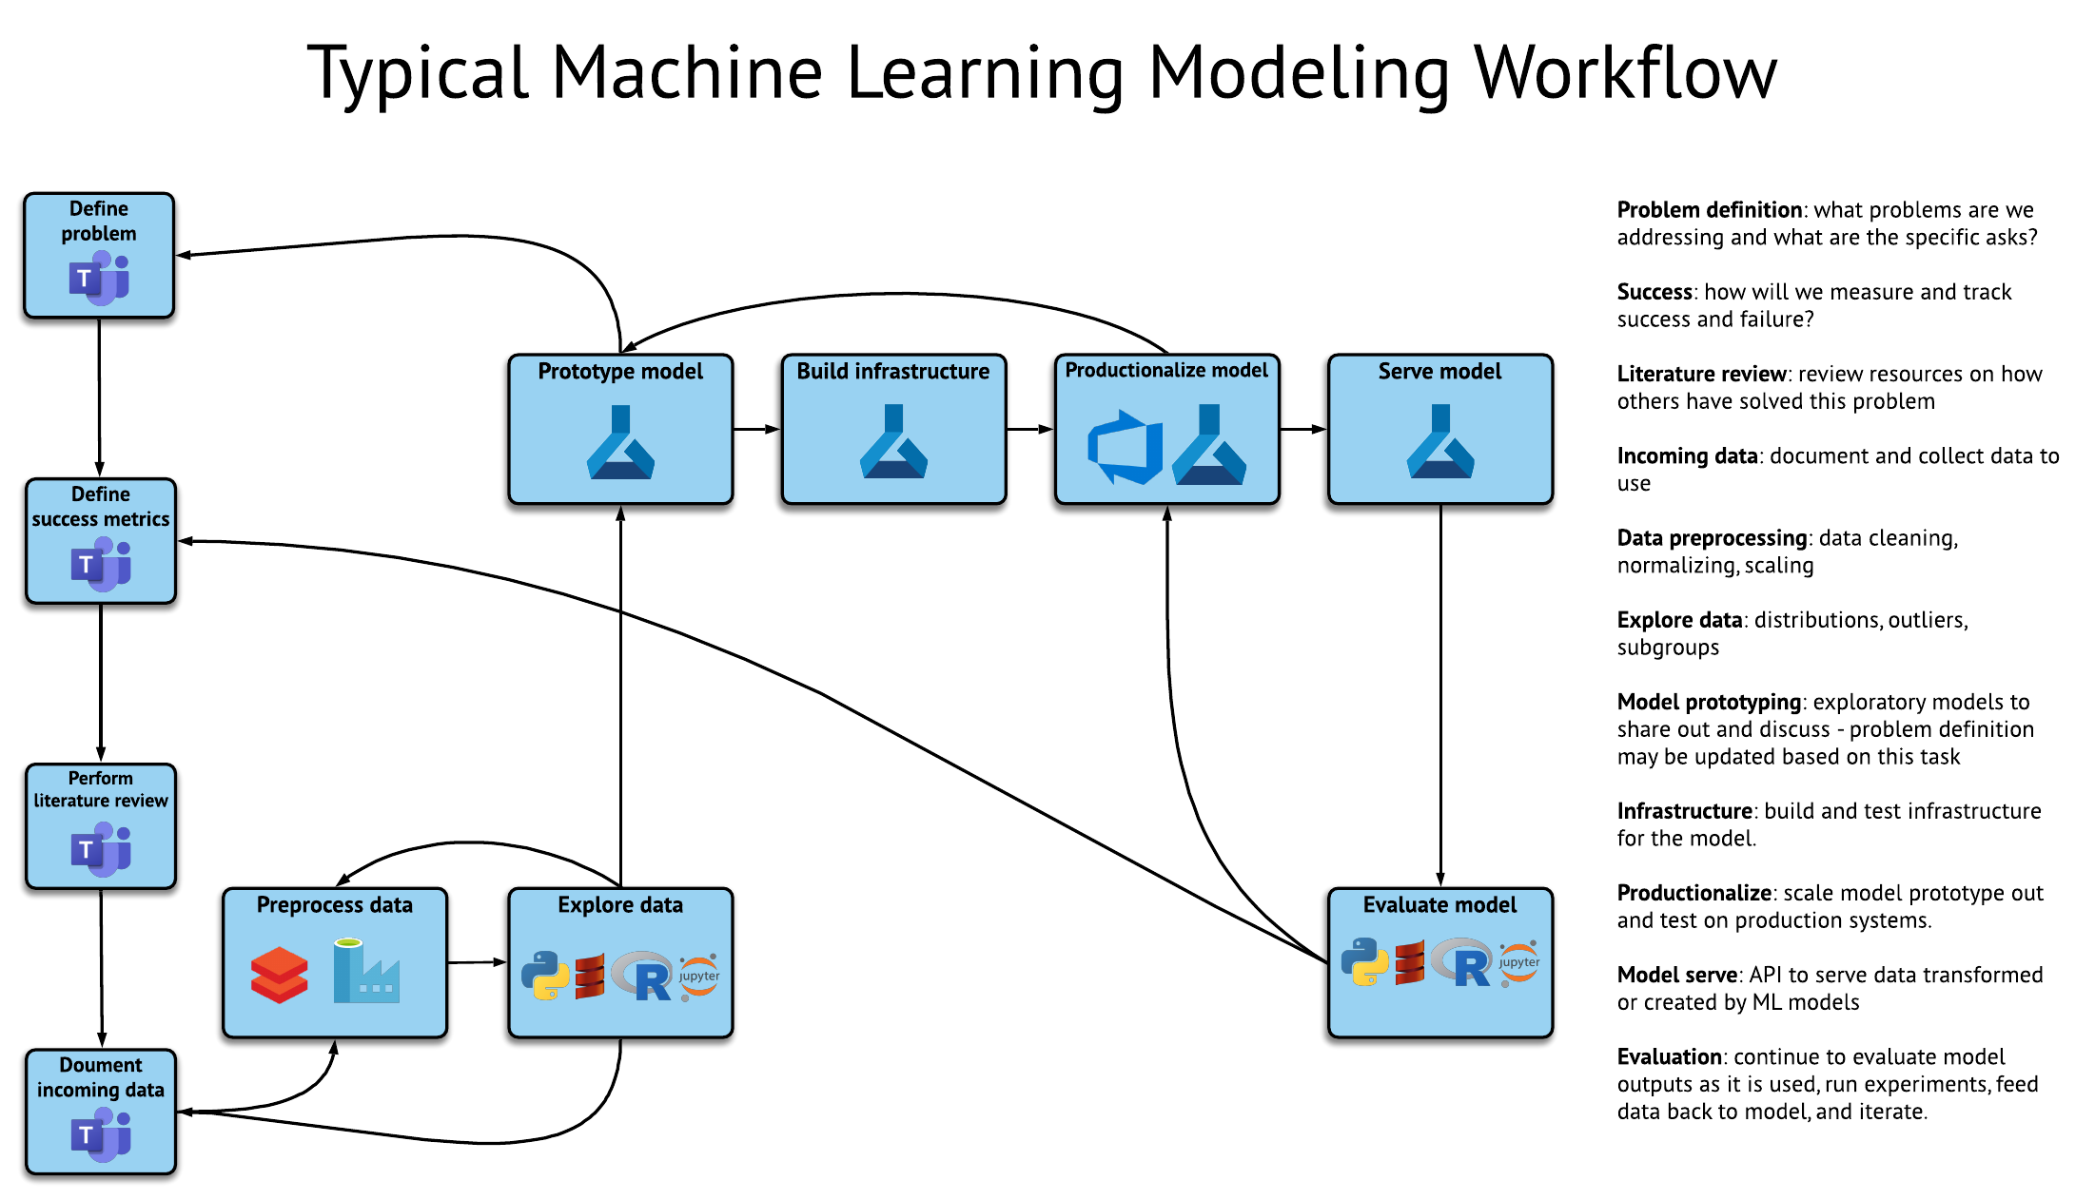
12
Notes:
Since I’m only focusing on the first four – and not SQL Server Machine Learning Services – either transition a strikethrough the last point or bold the first four points
Questions:
How does something like Cognitive Services fit into the picture?
Are folks going to ask about ML.NET? https://medium.com/datadriveninvestor/6-reasons-microsoft-has-become-the-go-to-for-machine-learning-e642864ef5f5#425e

Slide 13
Machine learning options on Azure
Azure Machine Learning service
Azure Machine Learning Studio
Azure Databricks
Azure Data Science Virtual Machine
SQL Server Machine Learning Services
Azure Machine Learning service
Azure Machine Learning Studio
Azure Databricks
Azure Data Science Virtual Machine
SQL Server Machine Learning Services
13
Notes:
Since I’m only focusing on the first four – and not SQL Server Machine Learning Services – either transition a strikethrough the last point or bold the first four points
Change the icons to reflect
Questions:
How does something like Cognitive Services fit into the picture?
Are folks going to ask about ML.NET? https://medium.com/datadriveninvestor/6-reasons-microsoft-has-become-the-go-to-for-machine-learning-e642864ef5f5#425e

Slide 14
Azure Machine Learning service
Azure Machine Learning Studio
Azure Databricks
Azure Data Science Virtual Machine
SQL Server Machine Learning Services
Supports data science pipeline integration
Allows for scaling up and automation
Allows for easily containerization and automation
14

Slide 15
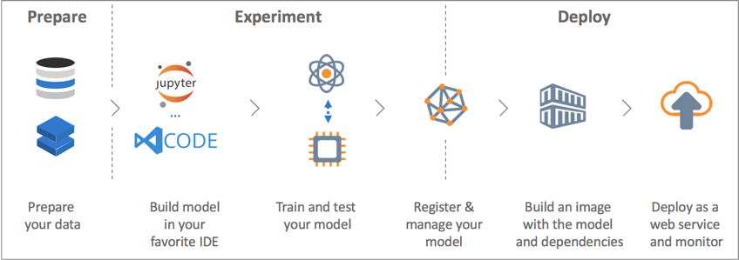
Azure Machine Learning service
Azure Machine Learning Studio
Azure Databricks
Azure Data Science Virtual Machine
SQL Server Machine Learning Services
15

Slide 16
Azure Machine Learning service
Azure Machine Learning Studio
Azure Databricks
Azure Data Science Virtual Machine
SQL Server Machine Learning Services
Data / BI Analyst
Data Scientist
Data Engineer
Data Scientist
Data Engineer
Data Science Manager
16
Notes:
Since I’m only focusing on the first four – and not SQL Server Machine Learning Services – either transition a strikethrough the last point or bold the first four points
Questions:
How does something like Cognitive Services fit into the picture?
Are folks going to ask about ML.NET? https://medium.com/datadriveninvestor/6-reasons-microsoft-has-become-the-go-to-for-machine-learning-e642864ef5f5#425e

Slide 17
Azure Machine Learning service
Azure Machine Learning Studio
Azure Databricks
Azure Data Science Virtual Machine
SQL Server Machine Learning Services
Data / BI Analyst
Data Scientist
Data Engineer
Data Scientist
Data Engineer
Data Science Manager
17

Slide 18
18
Notes:
Since I’m only focusing on the first four – and not SQL Server Machine Learning Services – either transition a strikethrough the last point or bold the first four points
Questions:
How does something like Cognitive Services fit into the picture?
Are folks going to ask about ML.NET? https://medium.com/datadriveninvestor/6-reasons-microsoft-has-become-the-go-to-for-machine-learning-e642864ef5f5#425e

Slide 19
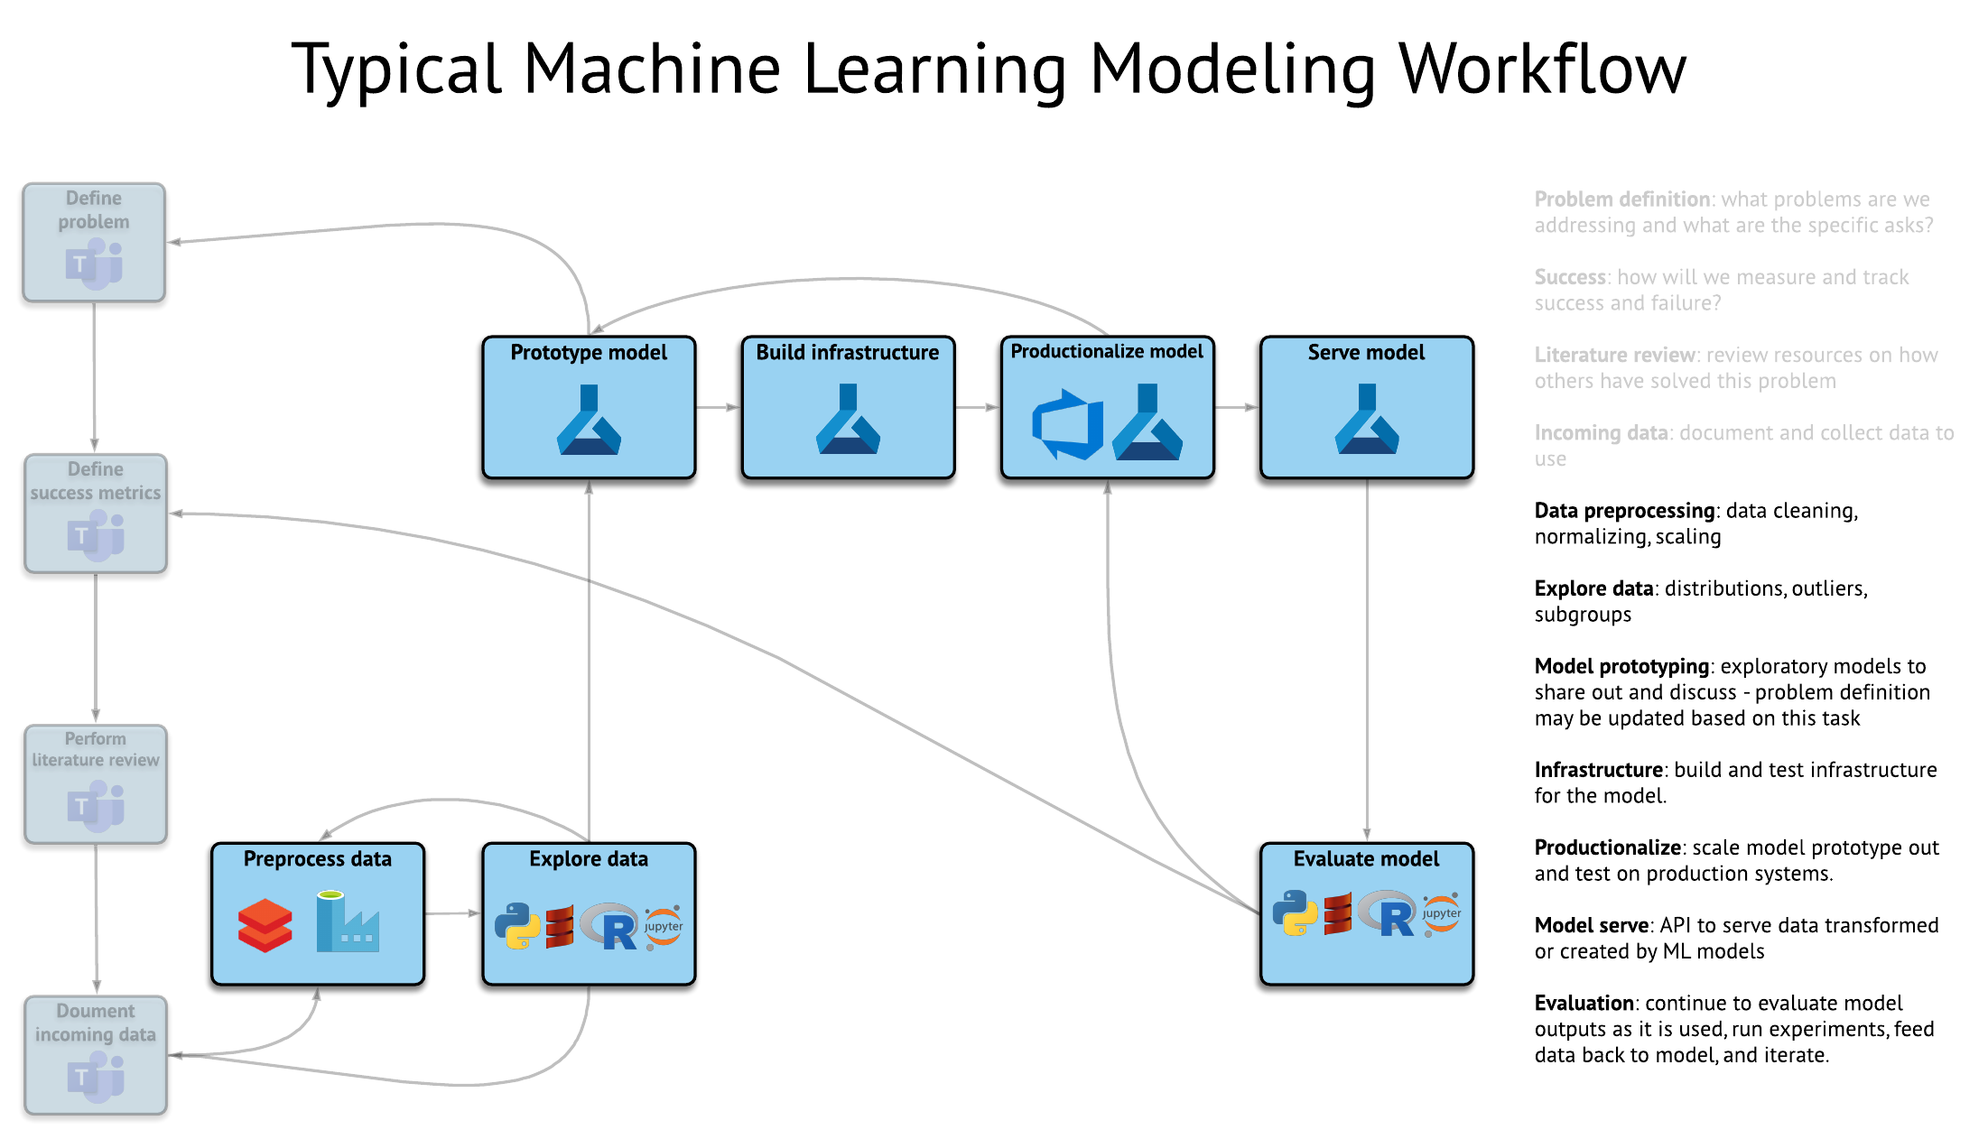
19
Notes:
Since I’m only focusing on the first four – and not SQL Server Machine Learning Services – either transition a strikethrough the last point or bold the first four points
Questions:
How does something like Cognitive Services fit into the picture?
Are folks going to ask about ML.NET? https://medium.com/datadriveninvestor/6-reasons-microsoft-has-become-the-go-to-for-machine-learning-e642864ef5f5#425e

Slide 20
What Does It Look Like?

Slide 21
Machine learning options on Azure
Azure Machine Learning service
Azure Machine Learning Studio
Azure Databricks
Azure Data Science Virtual Machine
SQL Server Machine Learning Services
Azure Machine Learning service
Azure Machine Learning Studio
Azure Databricks
Azure Data Science Virtual Machine
SQL Server Machine Learning Services
21
Notes:
Since I’m only focusing on the first four – and not SQL Server Machine Learning Services – either transition a strikethrough the last point or bold the first four points
Change the icons to reflect
Questions:
How does something like Cognitive Services fit into the picture?
Are folks going to ask about ML.NET? https://medium.com/datadriveninvestor/6-reasons-microsoft-has-become-the-go-to-for-machine-learning-e642864ef5f5#425e

Slide 22
Azure Machine Learning service
Azure Machine Learning Studio
Azure Databricks
Azure Data Science Virtual Machine
SQL Server Machine Learning Services
GUI-based, interactive platform that provides a visual display for the modeling process, including deployment options
Integrates a drag-and-drop method of the iterative data science process
Includes an automated deployment service that supports REST API calls to score data
22

Slide 23
Azure Machine Learning service
Azure Machine Learning Studio
Azure Databricks
Azure Data Science Virtual Machine
SQL Server Machine Learning Services
Data / BI Analyst
Data Scientist
Data Engineer
Data Scientist
Data Engineer
Data Science Manager
23
Notes:
Since I’m only focusing on the first four – and not SQL Server Machine Learning Services – either transition a strikethrough the last point or bold the first four points
Questions:
How does something like Cognitive Services fit into the picture?
Are folks going to ask about ML.NET? https://medium.com/datadriveninvestor/6-reasons-microsoft-has-become-the-go-to-for-machine-learning-e642864ef5f5#425e

Slide 24
Azure Machine Learning service
Azure Machine Learning Studio
Azure Databricks
Azure Data Science Virtual Machine
SQL Server Machine Learning Services
Data / BI Analyst
Data Scientist
Data Engineer
Data Scientist
Data Engineer
Data Science Manager
24
Notes:
Since I’m only focusing on the first four – and not SQL Server Machine Learning Services – either transition a strikethrough the last point or bold the first four points
Questions:
How does something like Cognitive Services fit into the picture?
Are folks going to ask about ML.NET? https://medium.com/datadriveninvestor/6-reasons-microsoft-has-become-the-go-to-for-machine-learning-e642864ef5f5#425e

Slide 25
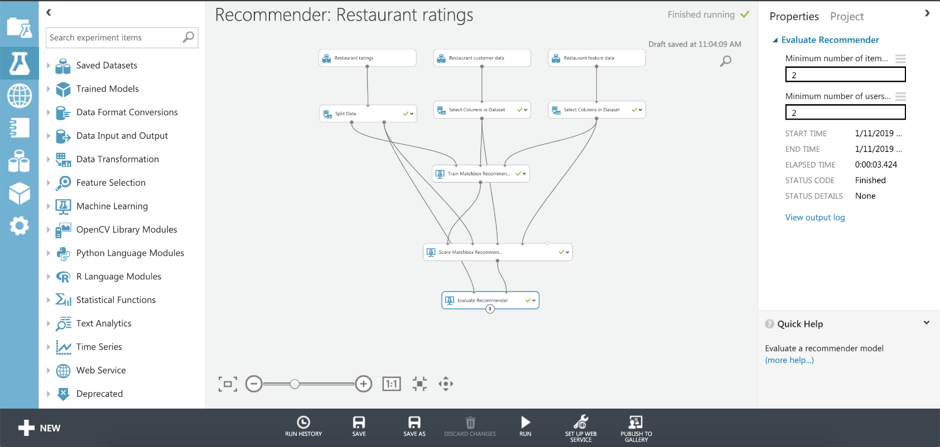
Azure Machine Learning service
Azure Machine Learning Studio
Azure Databricks
Azure Data Science Virtual Machine
SQL Server Machine Learning Services
25

Slide 26
26
Notes:
Since I’m only focusing on the first four – and not SQL Server Machine Learning Services – either transition a strikethrough the last point or bold the first four points
Questions:
How does something like Cognitive Services fit into the picture?
Are folks going to ask about ML.NET? https://medium.com/datadriveninvestor/6-reasons-microsoft-has-become-the-go-to-for-machine-learning-e642864ef5f5#425e

Slide 27
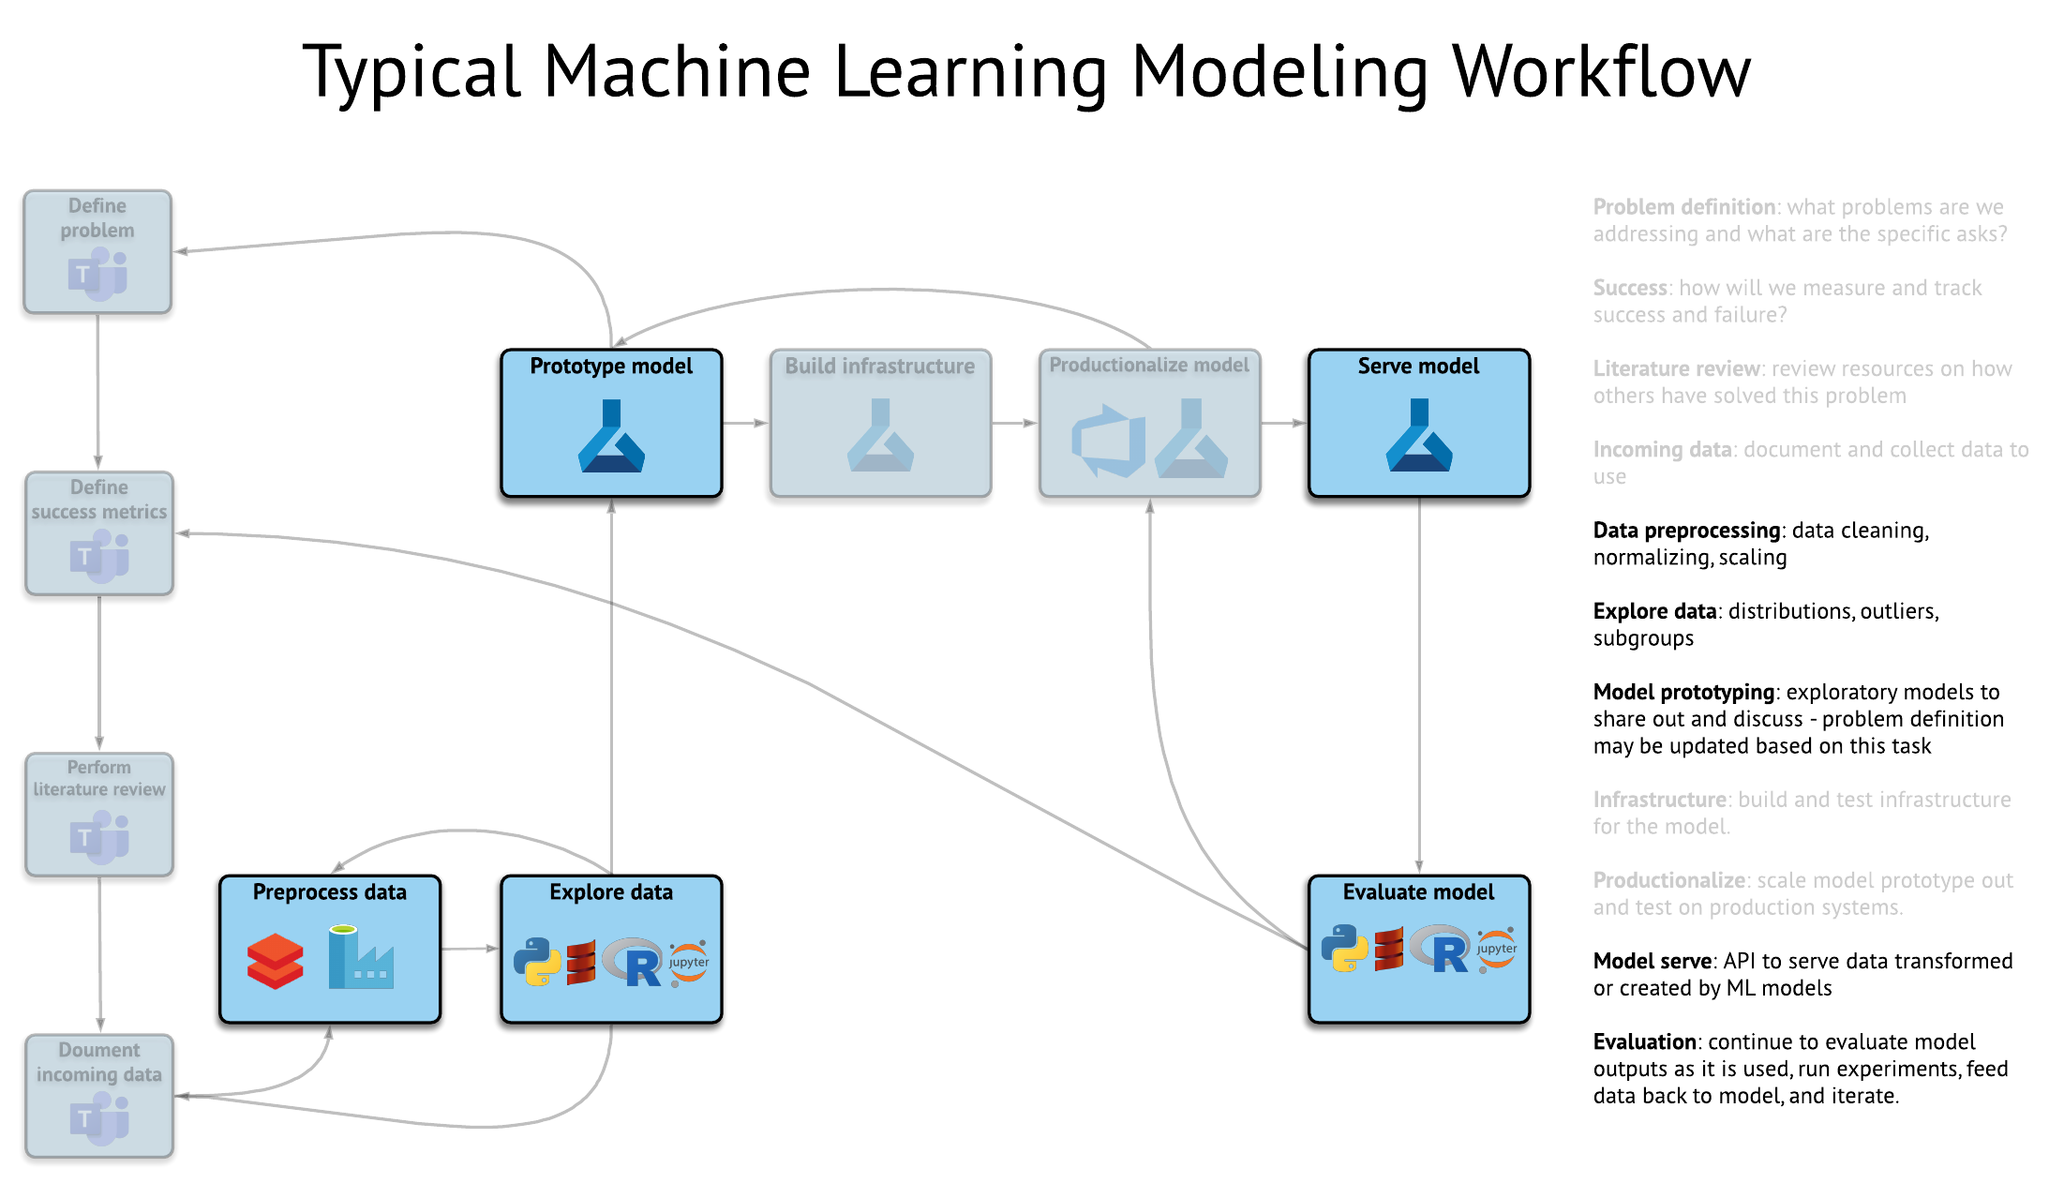
27
Notes:
Since I’m only focusing on the first four – and not SQL Server Machine Learning Services – either transition a strikethrough the last point or bold the first four points
Questions:
How does something like Cognitive Services fit into the picture?
Are folks going to ask about ML.NET? https://medium.com/datadriveninvestor/6-reasons-microsoft-has-become-the-go-to-for-machine-learning-e642864ef5f5#425e

Slide 28
What Does It Look Like?

Slide 29
Machine learning options on Azure
Azure Machine Learning service
Azure Machine Learning Studio
Azure Databricks
Azure Data Science Virtual Machine
SQL Server Machine Learning Services
Azure Machine Learning service
Azure Machine Learning Studio
Azure Databricks
Azure Data Science Virtual Machine
SQL Server Machine Learning Services
29
Notes:
Since I’m only focusing on the first four – and not SQL Server Machine Learning Services – either transition a strikethrough the last point or bold the first four points
Change the icons to reflect
Questions:
How does something like Cognitive Services fit into the picture?
Are folks going to ask about ML.NET? https://medium.com/datadriveninvestor/6-reasons-microsoft-has-become-the-go-to-for-machine-learning-e642864ef5f5#425e

Slide 30
Azure Machine Learning service
Azure Machine Learning Studio
Azure Databricks
Azure Data Science Virtual Machine
SQL Server Machine Learning Services
Secure, all-in-one data science team collaboration platform
Includes a notebook interface, job scheduling, Azure Active Directory integration, granular security control, and seamless Azure integration
GUI-based cloud portal that allows easy interaction with Spark big data platform
30
Notes:
Azure Databricks is an Apache Spark-based analytics platform widely used in machine learning for exploration and modeling. It enables the data scientist and data engineer to write code in data science notebooks using Java, Python, R, Scala, or SQL while also leveraging the power of distributed processing with automated cluster management.
Databricks environments and clusters can be created and managed automatically with Azure Resource Manager templates and PowerShell scripts. Azure Databricks also supports various types of visualizations out of the box using the display function. It is useful to remember that the work done here by a data scientist will, in general, center on supporting their experiments. It is too early to be thinking about scalability or resilience. But, if the experiment results in a compelling discovery for business, it will fall to the data engineer to deploy the project. In that case, this work does not necessarily need to be rebuilt. Azure Data Factory has connectors which enables a data engineer to trigger the running of Azure Databricks notebooks in a pipeline. They can assign compute power to scale the execution of notebooks on a cluster. With this capability the engineer can run notebooks consistently for the enterprise, orchestrated with other processes.

Slide 31
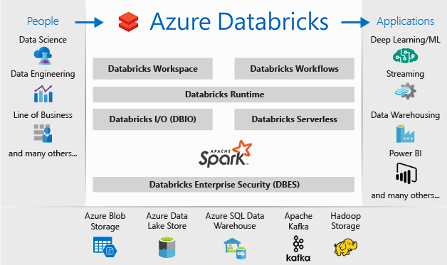
Azure Machine Learning service
Azure Machine Learning Studio
Azure Databricks
Azure Data Science Virtual Machine
SQL Server Machine Learning Services
31
Notes:
Azure Databricks is an Apache Spark-based analytics platform widely used in machine learning for exploration and modeling. It enables the data scientist and data engineer to write code in data science notebooks using Java, Python, R, Scala, or SQL while also leveraging the power of distributed processing with automated cluster management.
Databricks environments and clusters can be created and managed automatically with Azure Resource Manager templates and PowerShell scripts. Azure Databricks also supports various types of visualizations out of the box using the display function. It is useful to remember that the work done here by a data scientist will, in general, center on supporting their experiments. It is too early to be thinking about scalability or resilience. But, if the experiment results in a compelling discovery for business, it will fall to the data engineer to deploy the project. In that case, this work does not necessarily need to be rebuilt. Azure Data Factory has connectors which enables a data engineer to trigger the running of Azure Databricks notebooks in a pipeline. They can assign compute power to scale the execution of notebooks on a cluster. With this capability the engineer can run notebooks consistently for the enterprise, orchestrated with other processes.

Slide 32
Azure Machine Learning service
Azure Machine Learning Studio
Azure Databricks
Azure Data Science Virtual Machine
SQL Server Machine Learning Services
Data / BI Analyst
Data Scientist
Data Engineer
Data Scientist
Data Engineer
Data Science Manager
32

Slide 33
Azure Machine Learning service
Azure Machine Learning Studio
Azure Databricks
Azure Data Science Virtual Machine
SQL Server Machine Learning Services
Data / BI Analyst
Data Scientist
Data Engineer
Data Scientist
Data Engineer
Data Science Manager
33

Slide 34
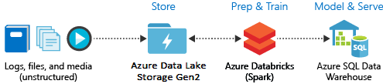
Azure Machine Learning service
Azure Machine Learning Studio
Azure Databricks
Azure Data Science Virtual Machine
SQL Server Machine Learning Services
34

Slide 35
35
Notes:
Since I’m only focusing on the first four – and not SQL Server Machine Learning Services – either transition a strikethrough the last point or bold the first four points
Questions:
How does something like Cognitive Services fit into the picture?
Are folks going to ask about ML.NET? https://medium.com/datadriveninvestor/6-reasons-microsoft-has-become-the-go-to-for-machine-learning-e642864ef5f5#425e

Slide 36
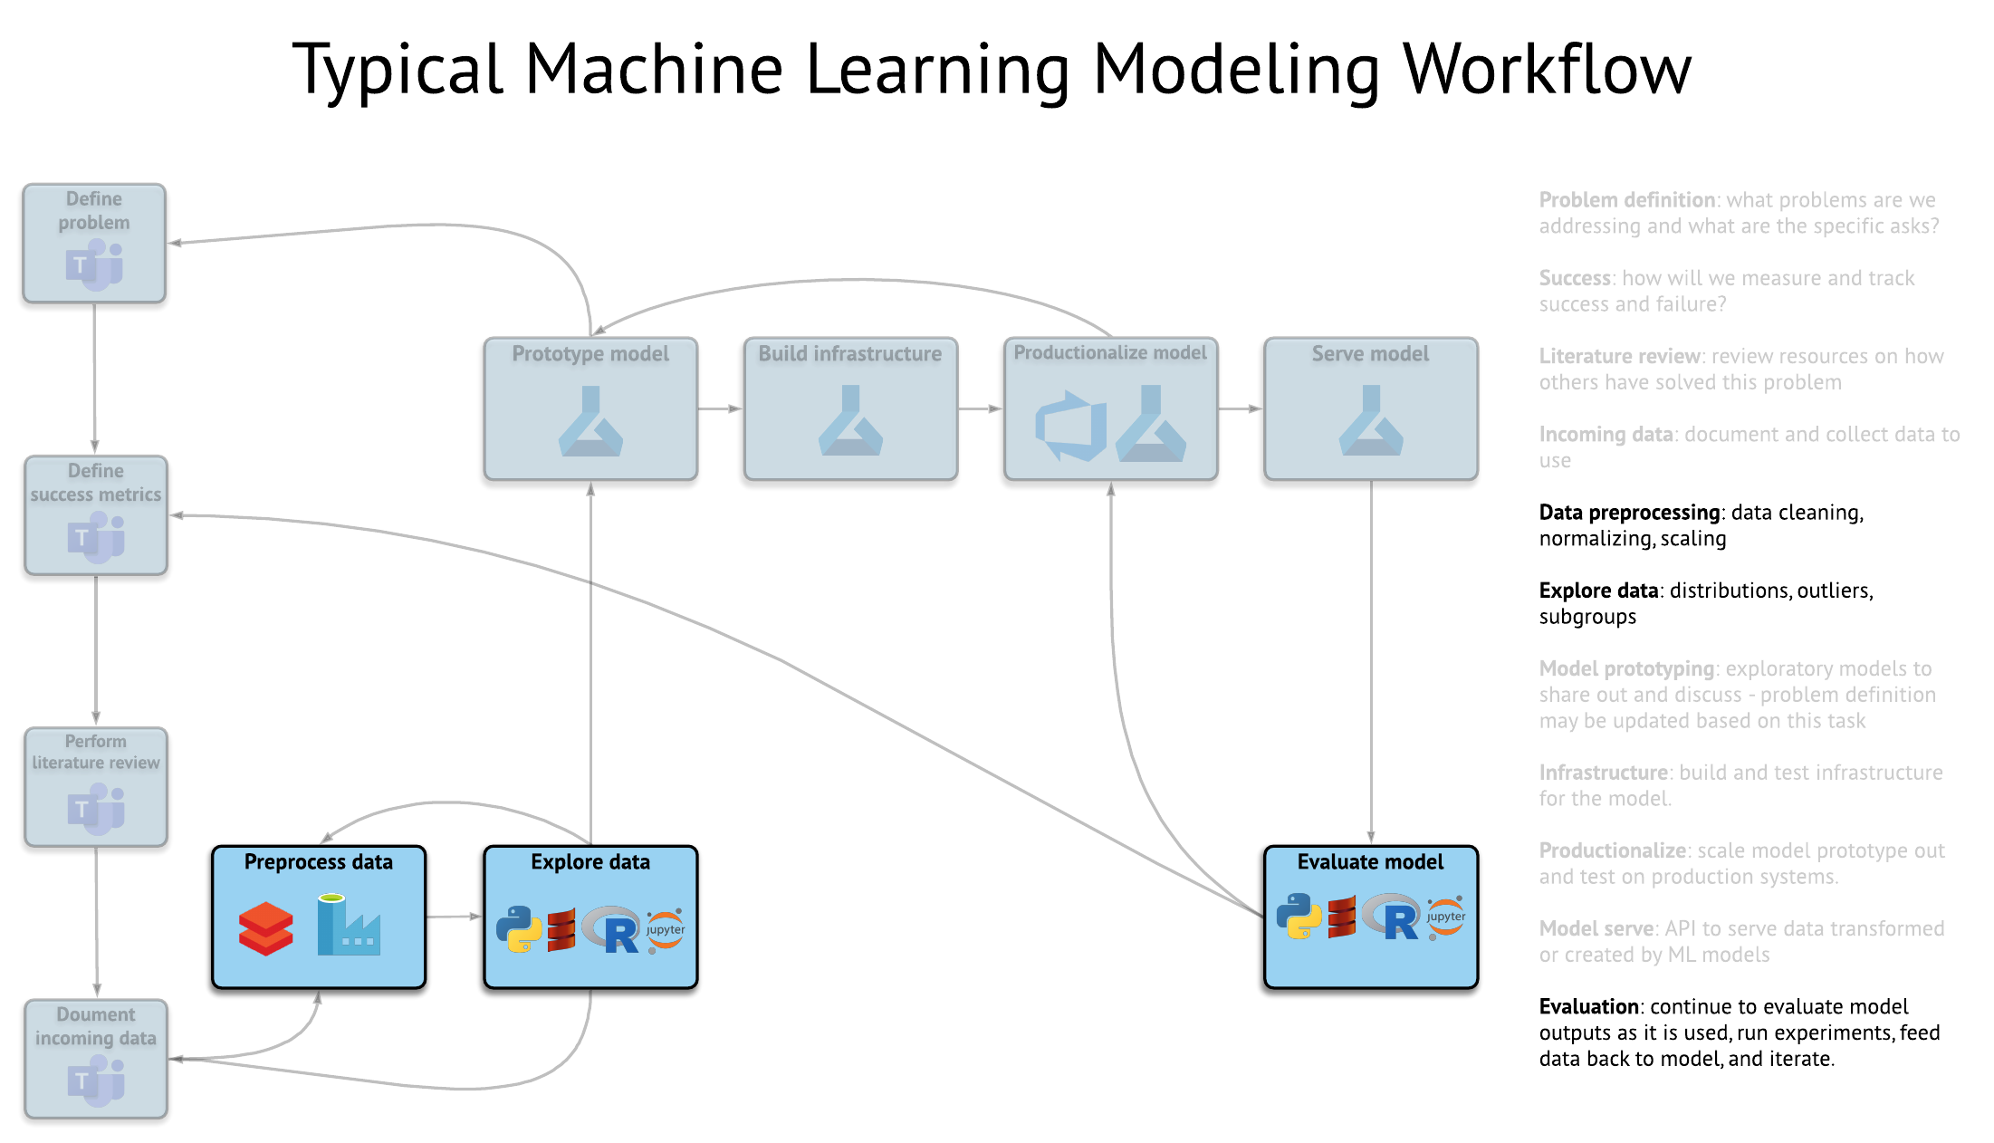
36
Notes:
Since I’m only focusing on the first four – and not SQL Server Machine Learning Services – either transition a strikethrough the last point or bold the first four points
Questions:
How does something like Cognitive Services fit into the picture?
Are folks going to ask about ML.NET? https://medium.com/datadriveninvestor/6-reasons-microsoft-has-become-the-go-to-for-machine-learning-e642864ef5f5#425e

Slide 37
What Does It Look Like?

Slide 38
Azure Machine Learning service
Azure Machine Learning Studio
Azure Databricks
Azure Data Science Virtual Machine
SQL Server Machine Learning Services
What is Data Science Virtual Machine (DSVM)?
Preconfigured virtual machines with many popular machine learning tools preinstalled
Provides a simple way to begin and iterate through the modeling process
38

Slide 39
Azure Machine Learning service
Azure Machine Learning Studio
Azure Databricks
Azure Data Science Virtual Machine
SQL Server Machine Learning Services
How do I use DSVM?
Use Microsoft Remote Desktop with administrator credentials for Windows-based DSVMs
Use SSH terminal sessions, X2Go graphical sessions, or Jupyter-based tooling (JupyterHub, JupyterLab, and Jupyter notebooks) for Linux-based DSVMs
39
Notes:
Content taken from here:
https://docs.microsoft.com/en-us/learn/modules/choose-data-science-option-in-azure/3-dsvm

Slide 40
Azure Machine Learning service
Azure Machine Learning Studio
Azure Databricks
Azure Data Science Virtual Machine
SQL Server Machine Learning Services
Sample Use Cases
Data science training and education
Data science hackathons
Custom compute for Azure Notebooks
Short-term GPU-based experimentation
40
Notes:
Content taken from here:
https://docs.microsoft.com/en-us/azure/machine-learning/data-science-virtual-machine/overview

Slide 41
Azure Machine Learning service
Azure Machine Learning Studio
Azure Databricks
Azure Data Science Virtual Machine
SQL Server Machine Learning Services
Data / BI Analyst
Data Scientist
Data Engineer
Data Scientist
Data Engineer
Data Science Manager
41
Notes:
Content taken from here:
https://docs.microsoft.com/en-us/azure/machine-learning/data-science-virtual-machine/overview

Slide 42
Azure Machine Learning service
Azure Machine Learning Studio
Azure Databricks
Azure Data Science Virtual Machine
SQL Server Machine Learning Services
Data / BI Analyst
Data Scientist
Data Engineer
Data Scientist
Data Engineer
Data Science Manager
42
Notes:
Content taken from here:
https://docs.microsoft.com/en-us/azure/machine-learning/data-science-virtual-machine/overview

Slide 43
Azure Machine Learning service
Azure Machine Learning Studio
Azure Databricks
Azure Data Science Virtual Machine
SQL Server Machine Learning Services
What is SQL Server Machine Learning Services (SSMLS)?
Supports scale up and high performance of Python and R code
Features include tighter security, the ability to schedule model training with the SQL Agent service, and persistence of models to database tables
Python and R code can be run in stored procedures and can interoperate with T-SQL
43

Slide 44
Azure Machine Learning service
Azure Machine Learning Studio
Azure Databricks
Azure Data Science Virtual Machine
SQL Server Machine Learning Services
Sample Use Cases
Create and score predictive models in Python and R
Write advanced text mining functions
Build and train machine learning and deep learning models
44

Slide 45
Azure Machine Learning service
Azure Machine Learning Studio
Azure Databricks
Azure Data Science Virtual Machine
SQL Server Machine Learning Services
Data / BI Analyst
Data Scientist
Data Engineer
Data Scientist
Data Engineer
Data Science Manager
45

Slide 46
Azure Machine Learning service
Azure Machine Learning Studio
Azure Databricks
Azure Data Science Virtual Machine
SQL Server Machine Learning Services
Data / BI Analyst
Data Scientist
Data Engineer
Data Scientist
Data Engineer
Data Science Manager
46

Slide 47
Questions?

Slide 48
Resources
Azure Machine Learning Service
Microsoft Learn: Azure Machine Learning Service https://docs.microsoft.com/en-us/learn/modules/choose-data-science-option-in-azure/8-azure-ml-service
Microsoft Docs: What is Azure Machine Learning? https://docs.microsoft.com/en-us/azure/machine-learning/service/overview-what-is-azure-ml
Azure Machine Learning Studio(classic)
Microsoft Learn: Azure Machine Learning Studio(classic) https://docs.microsoft.com/en-us/learn/modules/choose-data-science-option-in-azure/4-azure-ml-studio
Microsoft Docs: How Azure Machine Learning differs from ML Studio (classic)? https://docs.microsoft.com/en-us/azure/machine-learning/compare-azure-ml-to-studio-classic
Azure Databricks
Microsoft Learn: Azure Databricks https://docs.microsoft.com/en-us/learn/modules/choose-data-science-option-in-azure/7-azure-databricks
Microsoft Docs: What is Azure Databricks? https://docs.microsoft.com/en-us/azure/azure-databricks/what-is-azure-databricks
Data Science Virtual Machine
Microsoft Learn: Data Science Virtual Machine https://docs.microsoft.com/en-us/learn/modules/choose-data-science-option-in-azure/3-dsvm
Microsoft Docs: What is the Azure Data Science Virtual Machine for Linux and Windows? https://docs.microsoft.com/en-us/learn/modules/choose-data-science-option-in-azure/3-dsvm
SQL Server Machine Learning Services
Microsoft Learn: SQL Server Machine Learning Services https://docs.microsoft.com/en-us/learn/modules/choose-data-science-option-in-azure/5-sql-ml-server
Microsoft Docs: What is SQL Server Machine Learning Services (Python and R)? https://docs.microsoft.com/en-us/sql/advanced-analytics/what-is-sql-server-machine-learning?view=sql-server-ver15
48

Slide 49


